Slide 1
Population vs poverty
2017 US Census Data Analysis
Group Members:
Stephanie walters
Ziyan LU
Jodaisha palmer

Slide 2



Why Census Data/Weren’t You Doing a Sephora Project?!
Notes:
Discuss your findings. Did you find what you expected to find? If not, why not? What inferences or general conclusions can you draw from your analysis?

Slide 3

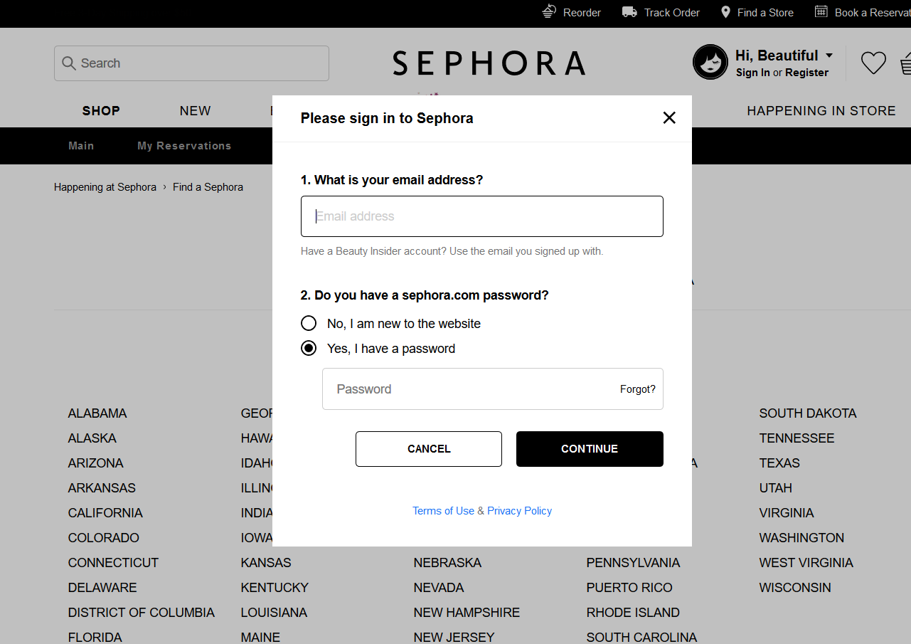
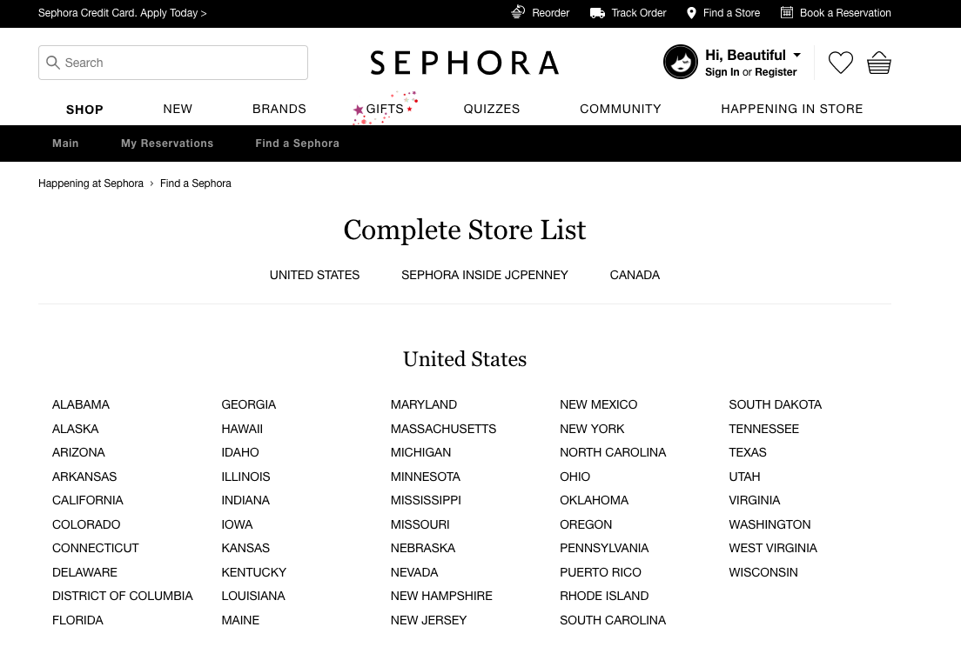

The Site’s UI
Notes:
Discuss your findings. Did you find what you expected to find? If not, why not? What inferences or general conclusions can you draw from your analysis?

Slide 4
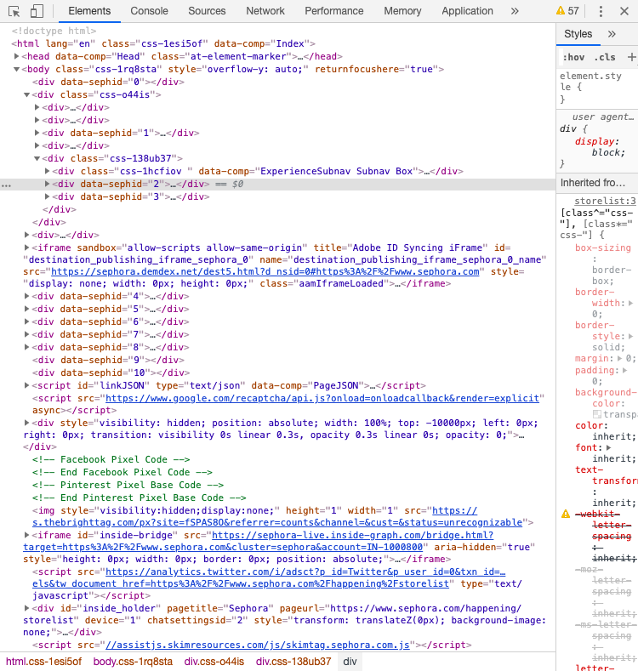
The Backend
Notes:
Discuss your findings. Did you find what you expected to find? If not, why not? What inferences or general conclusions can you draw from your analysis?

Slide 5
Back to Census Data…
Notes:
Discuss your findings. Did you find what you expected to find? If not, why not? What inferences or general conclusions can you draw from your analysis?

Slide 6
Evaluation structure
Motivation & overview
Questions & Data
Data CleanUp & Exploration
Interest in US population data
Desire to analyze the impact population count has on poverty count, age, and income
Hypotheses:
Areas with higher populations have a lower Median Age
Per Capita Income is higher in places with higher populations
Poverty count is higher within area with high populations
What kind of data is needed?
Census Data
Zipcode Data
What sources where used?
Census.org
publicopendatasoft.com
Retrieve demographic data from 2017 US census via an API
Retrieve zipcode data via a csv download
Data munging
Identify poverty count, median age, and per capita income
Explore population vs demographic correlation
Notes:
Discuss the steps you took to analyze the data and answer each question you asked in your proposal
Present and discuss interesting figures developed during analysis, ideally with the help of Jupyter Notebook

Slide 7
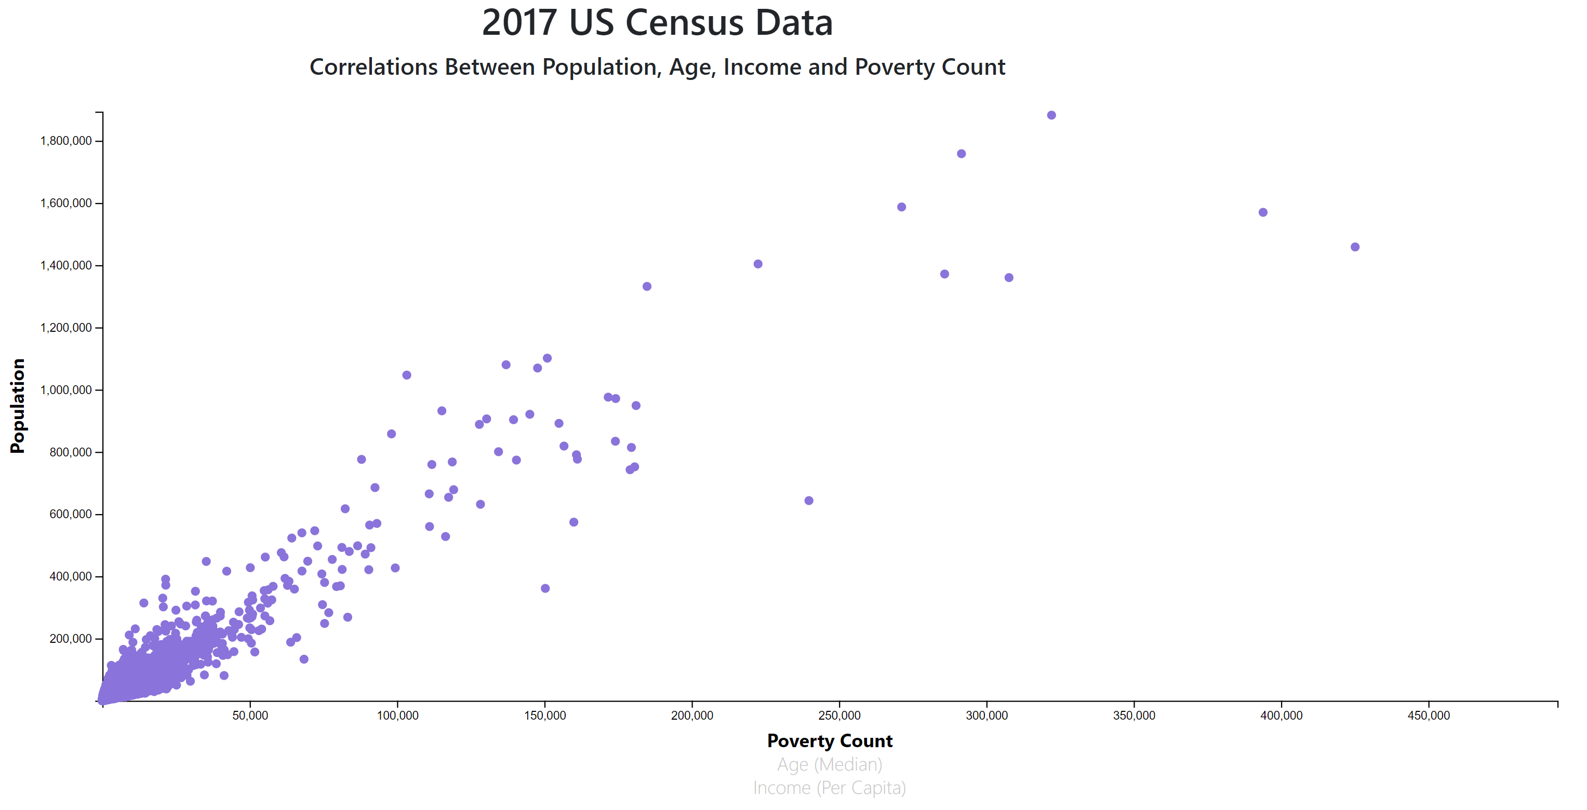

Slide 8
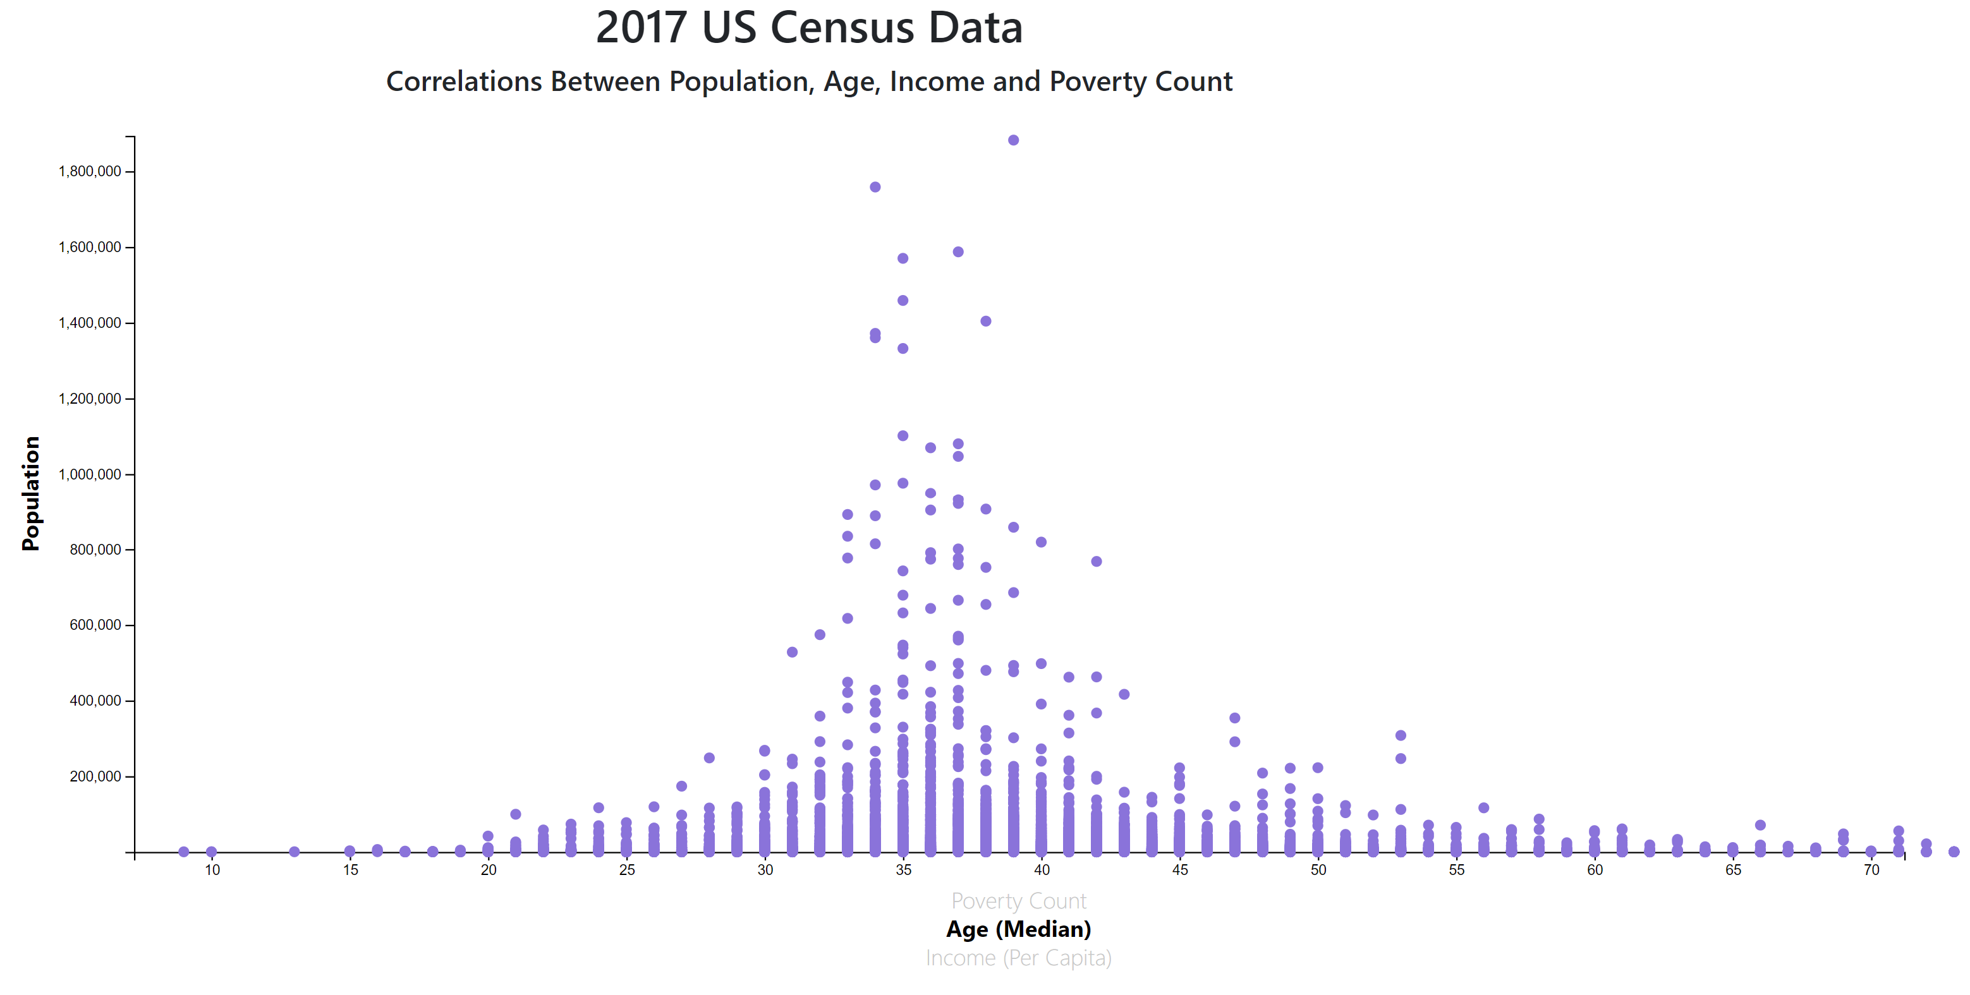

Slide 9
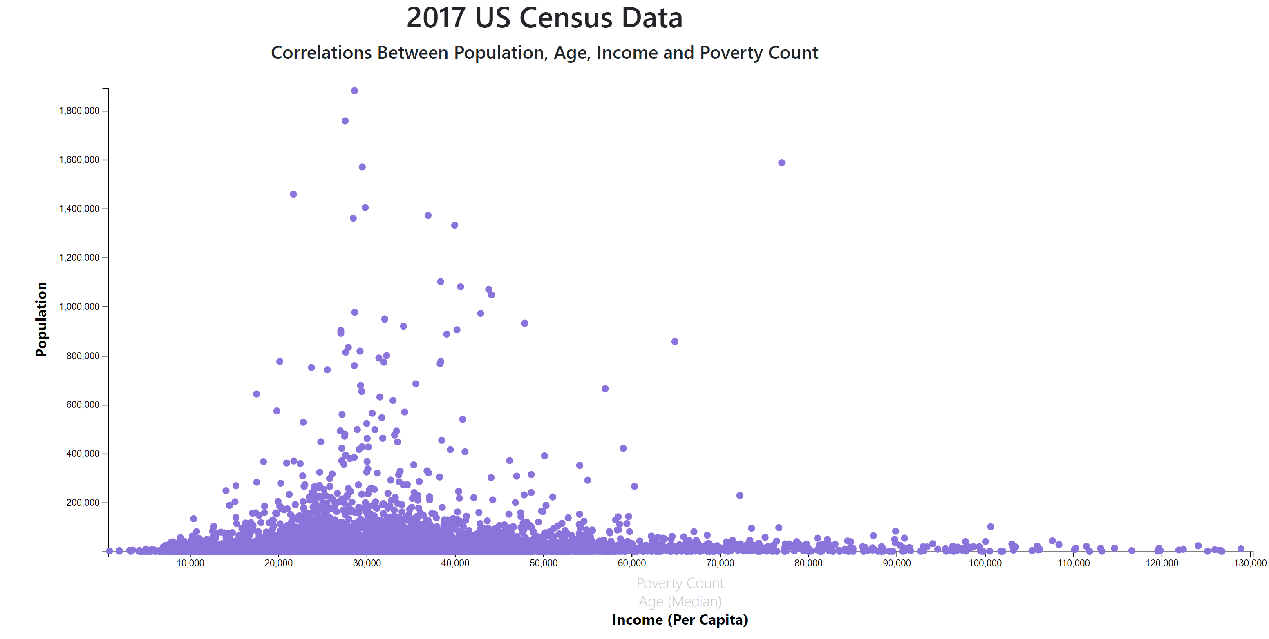

Slide 10
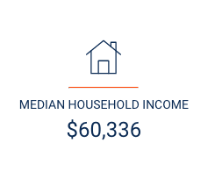
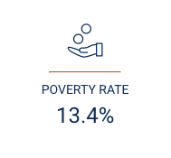
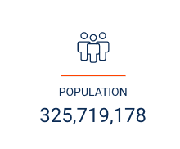
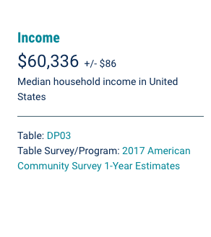
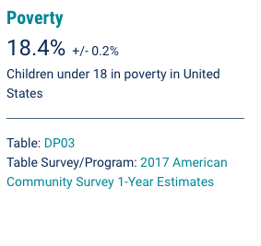
2017 US Census Stats
Sited by US Census Bureau

Slide 11
Post Mortem
Difficulties
Original project plan: Sephora Storefront Analysis. Challenges with web scraping data
Identify an alternative to match zip codes to a longitude and latitudes in order to visualize data
Time constraints
Notes:
Discuss your findings. Did you find what you expected to find? If not, why not? What inferences or general conclusions can you draw from your analysis?

